Slide 1

PROJECT ON
Exploratory Data Analysis (EDA) On Loan Sanction Dataset
Presented By:
P.Greeshma
I.Lalitha
A.Priya

Slide 2
About Me
My name is P.Greeshma, and I hold a B.Tech degree in Artificial Intelligence & Data Science from RSREC,Nellore, A.P. I am passionate about expanding my skill set by learning Data Science, as it offers powerful tools to analyze complex data and derive meaningful insights that can drive innovation and decision-making in various industries. Though I do not have prior work experience, I am eager to apply my technical background and analytical mindset to master data science concepts and contribute effectively to future projects.
Connect with Me
LinkedIn: linkedin.com/in/greeshmareddy08
GitHub: github.com/greeshma078
EMail: greeshmareddy0708@gmail.com

Slide 3
Dataset Overview
The Loan Sanction dataset contains information related to loan applicants and is used to analyze and predict whether a loan will be approved or not. The dataset consists of 614 records and 13 features, including demographic details, financial information, and credit history of applicants.
Columns include: 'Loan ID', 'Gender', 'Married', 'Dependents', 'Education’, 'Self Employed', 'Applicant Income', ‘Co applicant Income', 'Loan Amount’, 'Loan Amount Term', 'Credit History', 'Property Area', 'Loan Status’]
Data types are 8 categorical and 5 numerical columns

Slide 4
Simple description of each column in your dataset:
Loan ID:Unique identification number assigned to each loan applicant
Gender:Gender of the applicant (Male/Female)
Married:Marital status of the applicant (Yes/No)
Dependents:Number of dependents the applicant has
Education:Education level of the applicant (Graduate/Not Graduate)
Self_Employed:Indicates whether the applicant is self-employed (Yes/No)
Applicant Income:Income of the primary applicant
Co applicant Income:Income of the co-applicant (if any)
Loan Amount:Loan amount requested (in thousands)
Loan Amount Term:Duration of the loan in months
Credit History:Credit history of the applicant (1 = good credit history, 0 = bad)
Property Area:Area where the property is located (Urban/Semiurban/Rural)
Loan StatusTarget variable indicating loan approval status (Y = Approved, N = Rejected)

Slide 5
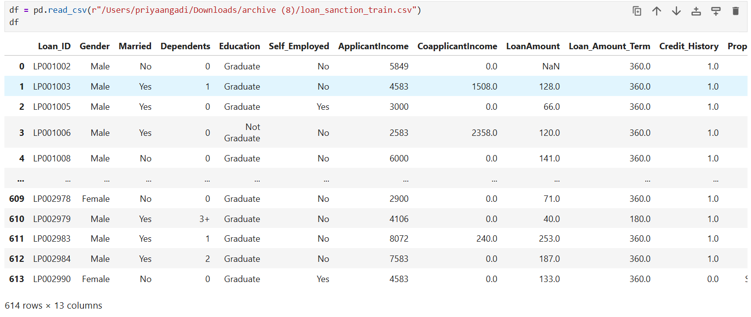
Reading Dataset

Slide 6
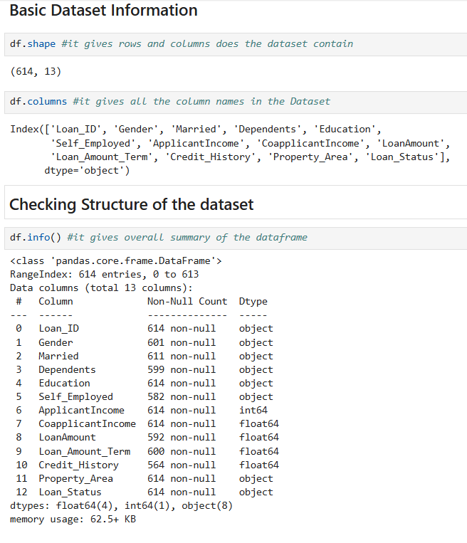
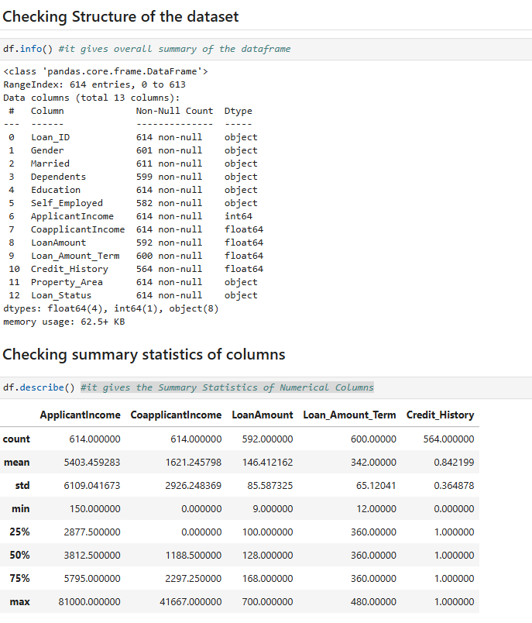
Basic Checks

Slide 7
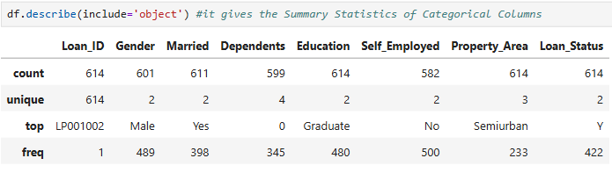
Basic Checks
This command generates summary statistics for categorical columns, showing the number of unique values, the most frequent category, and its frequency.

Slide 8
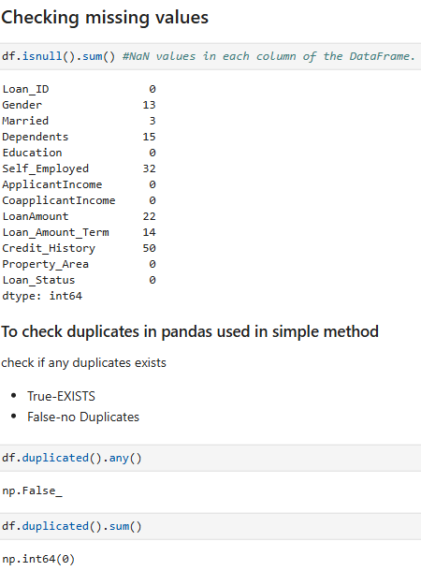
Preprocessing Techniques on Dataset Individual Columns
7 Columns have Missing Values
No duplicates
Now ,I want to perform some Preprocessing Techniques on columns like:
✔ Handling Missing Values
✔ Handling Inconsistence Data
✔ Data Type Conversions

Slide 9
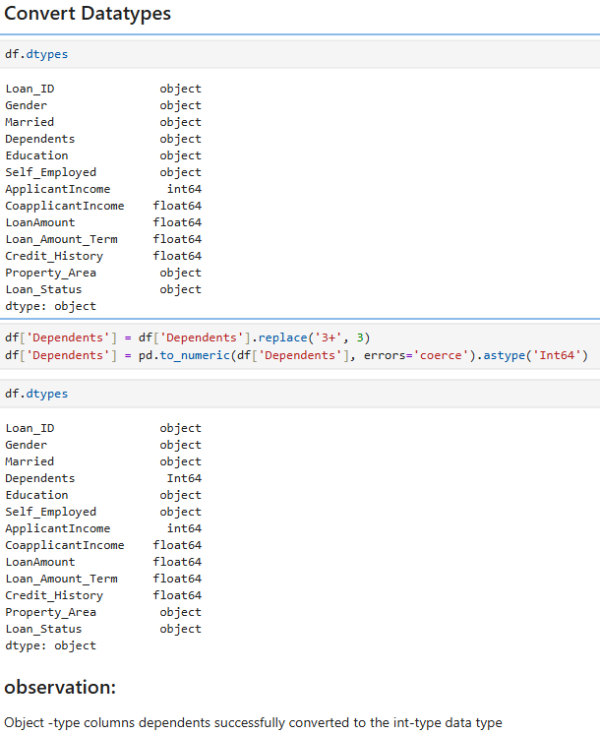
DATA TYPE CORRECTION
The categorical column
('Dependents’)were converted from
Object data type to Int data type.
which improves data understanding,
memory efficiency, and analysis
performance.

Slide 10
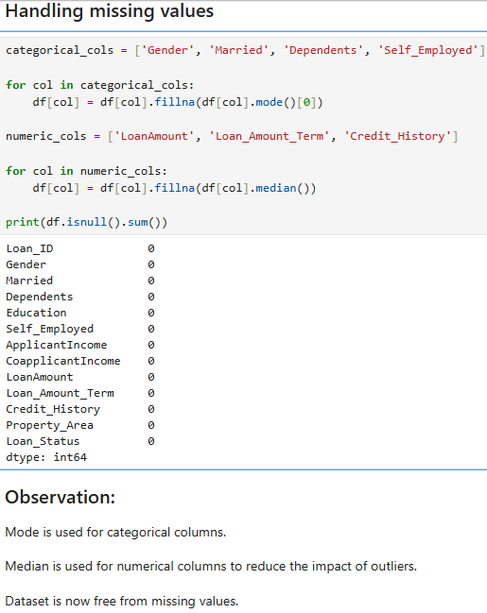
DATA HANDLING
Categorical columns (like Gender, Married, Dependents, Self_Employed):
Missing values are filled using the Mode of each column. The mode is the most frequent category, so replacing missing entries with it ensures consistency and avoids unrealistic values
Numerical columns (like LoanAmount, Loan_Amount_Term, Credit_History):
Missing values are filled using the Median of each column. The median is preferred over the mean because it is not affected by extreme outliers and better represents the central tendency of the data.

Slide 11
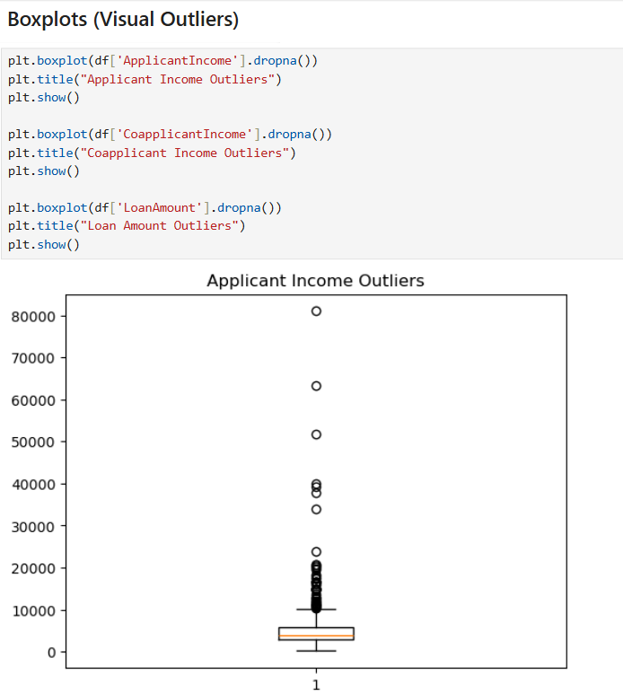
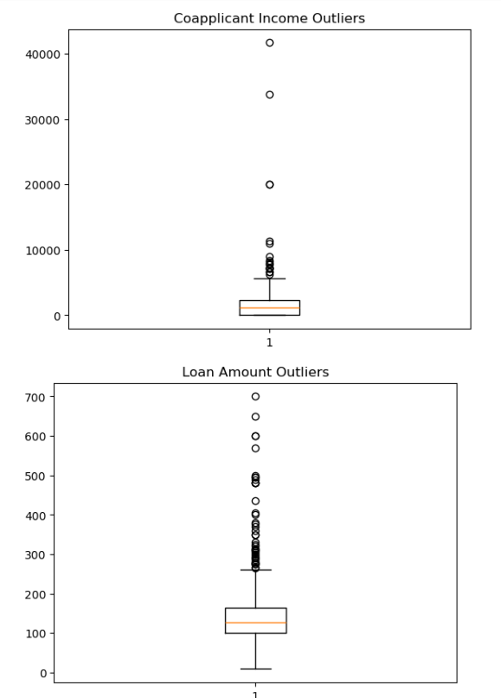
UNIVARIATE ANALYSIS
ApplicantIncome shows a right‑skewed distribution with a few very high but realistic incomes.
CoapplicantIncome has valid zeros along with some extreme high values that stand out as outliers.
LoanAmount is mostly within a normal range, but a few very large requests appear as unusual outliers needing review.

Slide 12
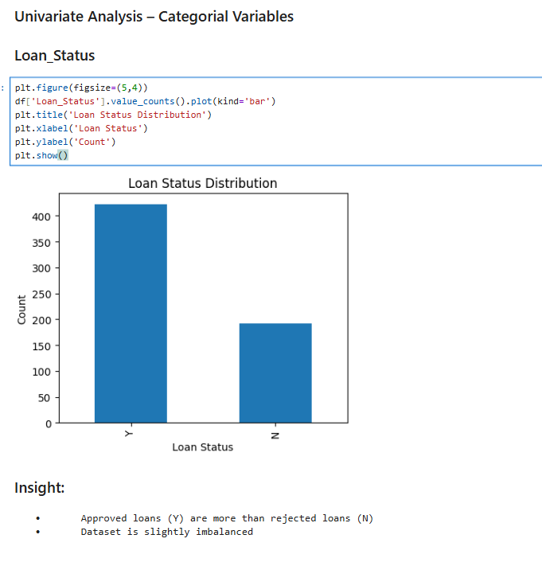
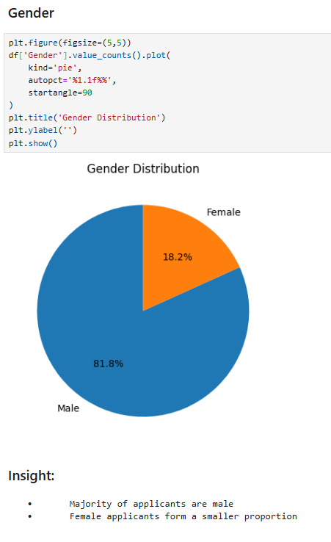
Univariate Analysis - Categorical and Numerical
Approved loans are higher than rejected ones, making the dataset slightly imbalanced.
This imbalance means models may favor approvals, so careful evaluation and balancing techniques are needed.
The dataset shows a clear gender imbalance, with male applicants forming the majority.
Female applicants represent a smaller share, which may influence patterns in loan approval analysis.

Slide 13
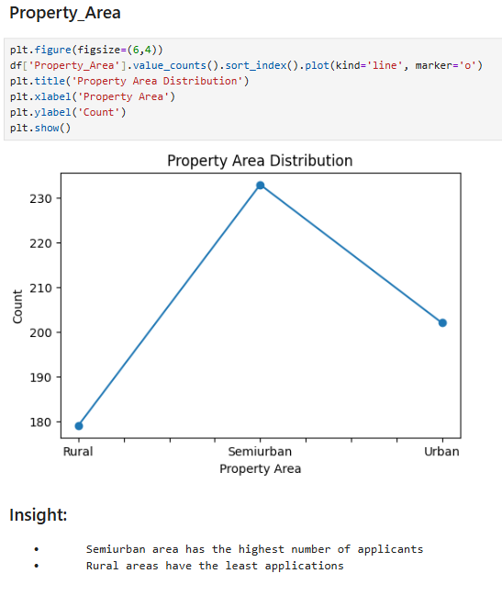
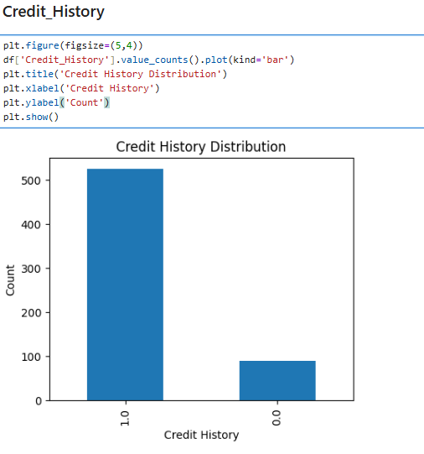
UNIVARIATE ANALYSIS
Most applicants have a positive credit history (value = 1),
while fewer applicants have no or poor credit history
(value = 0).
This indicates that credit history is skewed toward good records, and since loan approval is strongly linked to credit history, applicants with a positive record are more likely to get their loans approved.
The dataset shows that most loan applicants come from semi‑urban areas, making it the dominant group.
Rural areas contribute the least number of applications, highlighting a clear regional imbalance.

Slide 14
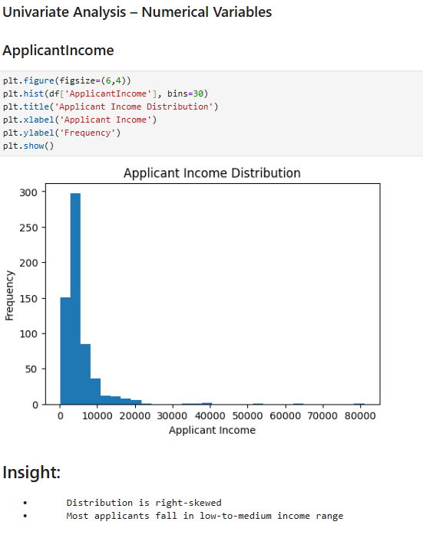
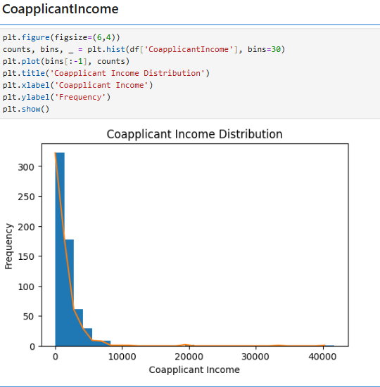
Univariate Analysis - Categorical and Numerical
The income distribution is right‑skewed, with a long tail of high earners.
Most applicants belong to the low‑to‑medium income range, forming the bulk of the dataset.
The co‑applicant income distribution shows many applicants with zero income, which is valid when no co‑applicant exists.
A few cases have very high incomes, appearing as outliers compared to the majority.

Slide 15
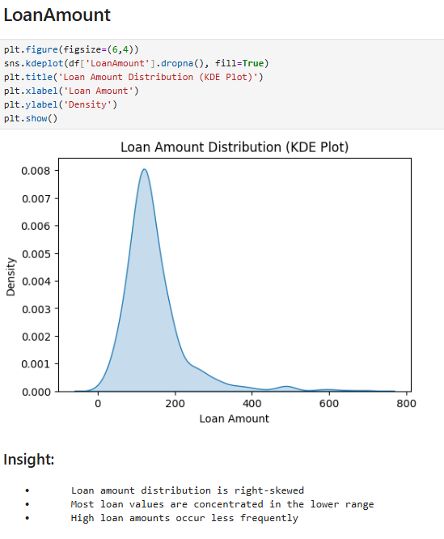
Univariate Analysis - Categorical and Numerical
The loan amount distribution is right‑skewed, with most values concentrated in the lower range.
Only a few applicants request very high loan amounts, making such cases less frequent.

Slide 16
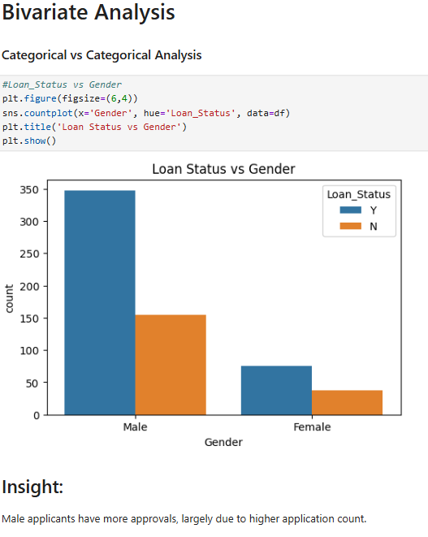
Bivariate Analysis-Categorical Vs Numerical
Male applicants show a higher number of loan approvals, mainly because they submit more applications.
This trend reflects the larger male applicant base rather than a bias in approval decisions.

Slide 17
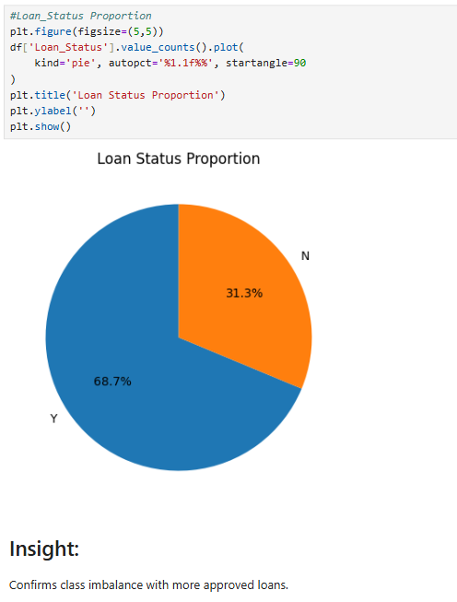
Bivariate Analysis-Categorical Vs Numerical
The dataset confirms a class imbalance, with approved loans outnumbering rejected ones.
This imbalance may cause models to favor approvals, so careful evaluation is required.

Slide 18
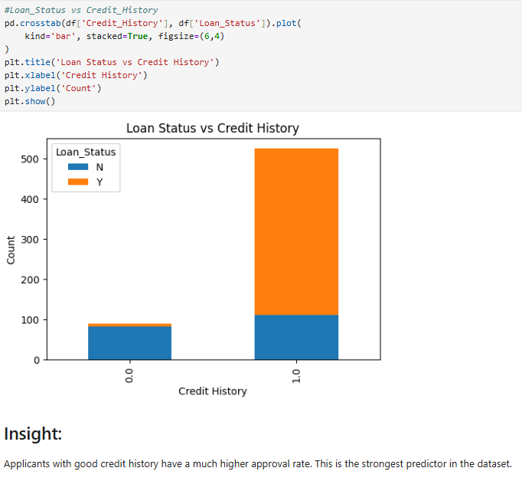
Bivariate Analysis-Categorical Vs Numerical
Applicants with a positive credit history show significantly higher loan approval rates.
Credit history emerges as the most powerful predictor in the dataset.

Slide 19
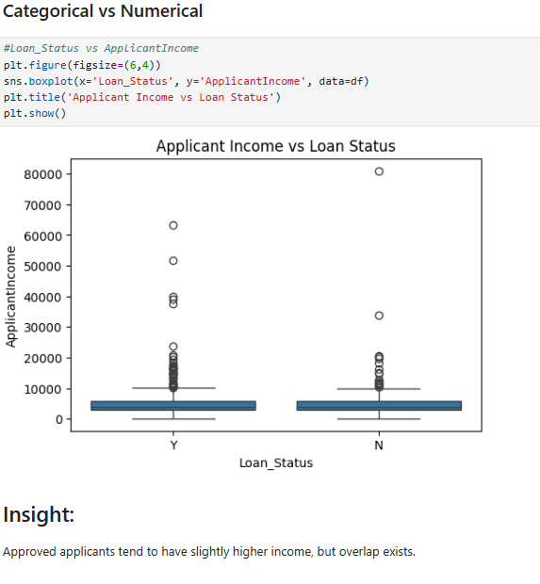
Bivariate Analysis-Categorical Vs Numerical
Approved applicants generally have somewhat higher incomes compared to rejected ones.
However, there is noticeable overlap, meaning income alone does not fully determine approval.

Slide 20
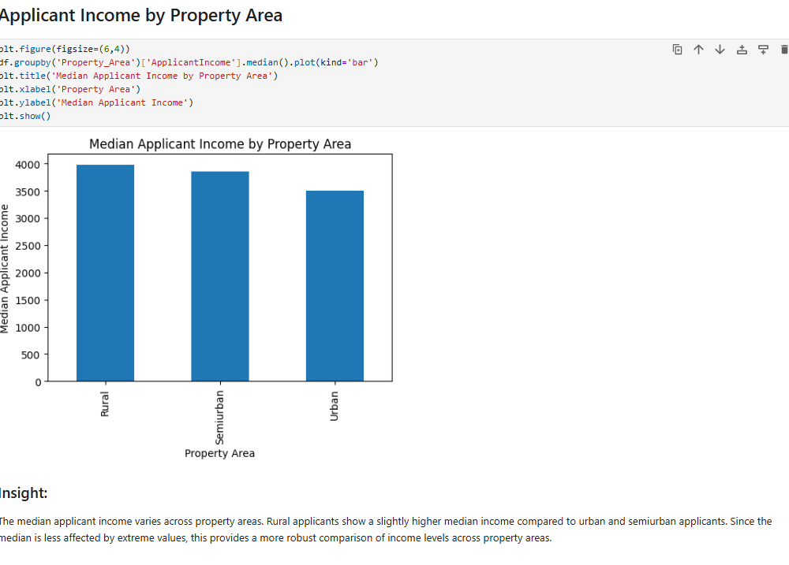
Bivariate Analysis-Categorical Vs Numerical
The median applicant income varies across property areas. Rural applicants show a slightly higher median income compared to urban and semiurban applicants.
Since the median is less affected by extreme values, this provides a more robust comparison of income levels across property areas.

Slide 21
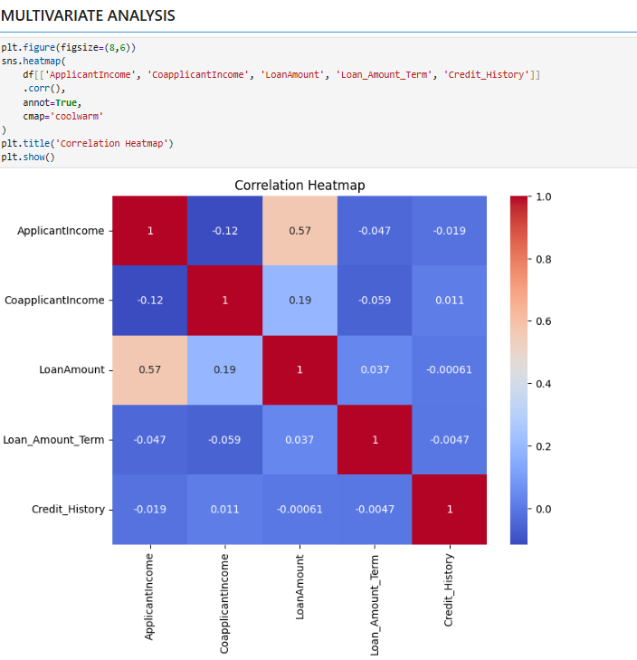
Multivariate Analysis
Applicant Income and Loan Amount have a moderate positive correlation, while Co applicant Income shows only a weak link.
Credit History has very low correlation with income variables, and no strong multicollinearity is present.

Slide 22
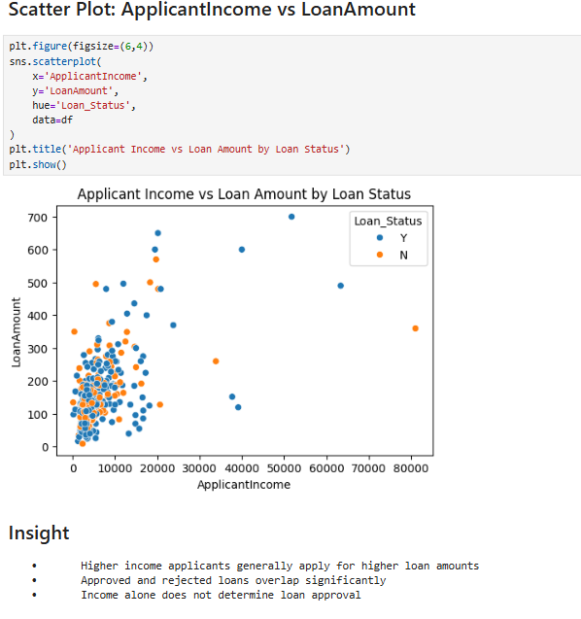
Multivariate Analysis
Applicants with higher incomes usually request larger loan amounts.
However, approvals and rejections overlap, showing that income alone doesn’t decide loan approval.

Slide 23
OVERALL INSIGHTS
Higher applicant income and combined applicant–co-applicant income increase loan approval chances, as they indicate stronger repayment capability.
Credit history is the most influential factor, with applicants having a good credit record receiving significantly more approvals.
Married applicants generally have higher approval rates, while approval probability decreases as the number of dependents increases.
Graduates show a slightly higher loan approval rate compared to non-graduates, reflecting better financial credibility.
Applicants from urban and semi-urban areas and those in salaried employment receive more loan approvals than rural and self-employed applicants.

Slide 24
CHALLENGES
Several key variables, such as loan amount and credit history, contain missing values that required careful preprocessing to avoid biased results.
The dataset is imbalanced, with a higher number of approved loans, which may affect the performance and fairness of predictive models.
Extreme outliers in applicant income and loan amount can distort analysis and needed treatment for accurate modeling.
Multiple categorical features required encoding and transformation before applying machine learning algorithms.
The absence of detailed financial behavior data, such as liabilities and spending patterns, limits overall prediction accuracy.

Slide 25
CONCLUSION
Loan approval is primarily driven by credit history, followed by income and property area.
Demographic features such as education, marital status, and employment type play a secondary role.
Proper handling of missing values and outliers is essential for reliable analysis.
The dataset is suitable for building a loan approval prediction model, but model performance can be improved with additional financial and behavioral features.

Slide 26

Thank You

